Slide 1
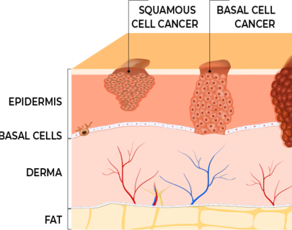
Explainable Deep Learning Framework for Skin Cancer Classification
Suriya Islam Chowdhury

Slide 2
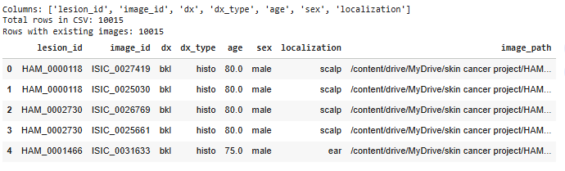
Problem Statement & Dataset
CNNs perform well but operate as black boxes.
Clinicians need to understand why a model makes a prediction.
Objective:
Build a multi-class classifier for 7 skin lesion types.
Integrate explainability techniques (Grad-CAM, IG, SHAP).
Ensure both accuracy and clinical interpretability.
Dataset: HAM10000
Total: 10,015 dermatoscopic images
7 lesion categories: MEL, NV, BCC, AKIEC, BKL, DF, VASC

Slide 3


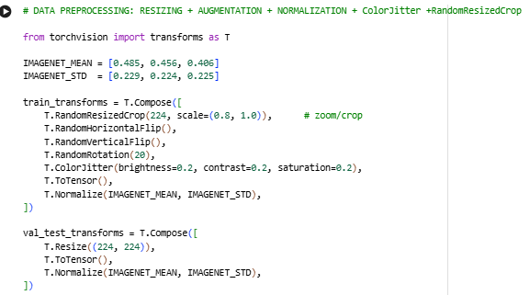
Preprocessing Pipeline
Resize images to 224×224 (ResNet50 requirement)
ImageNet normalization
Data augmentation: rotation, flipping
Class-weighted sampling to reduce imbalance
Custom PyTorch Dataset & DataLoader for efficient batching
ColorJitter
Brightness
Contrast
Saturation
This augmentation forces the model to focus on lesion structure and pattern rather than being overly sensitive to small lighting changes.

Slide 4
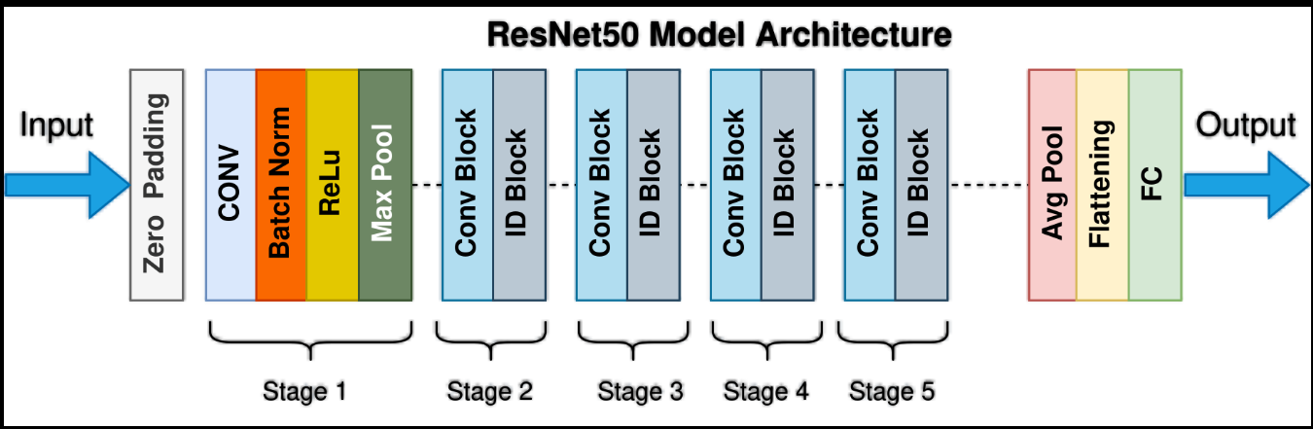
Model Architecture
Backbone: ResNet50 pretrained on ImageNet
Replaced final FC layer → 7-class output
Loss: Class-weighted Cross Entropy
Optimizer: AdamW (LR=1e-4, WD=1e-4)
Implemented using PyTorch with GPU acceleration

Slide 5
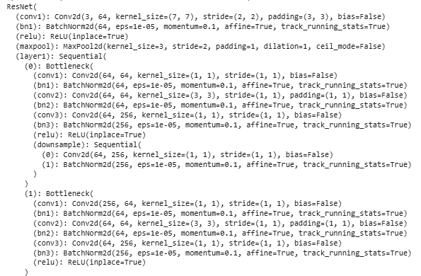
Model Architecture
Feature Extraction Backbone (ResNet50)
Starts with a 7×7 convolution → BatchNorm → ReLU → MaxPool.
Followed by four residual stages (layer1–layer4) made of bottleneck blocks with skip connections.
Channel progression across stages:
Layer1: 64 → 256
Layer2: 128 → 512
Layer3: 256 → 1024
Layer4: 512 → 2048

Slide 6
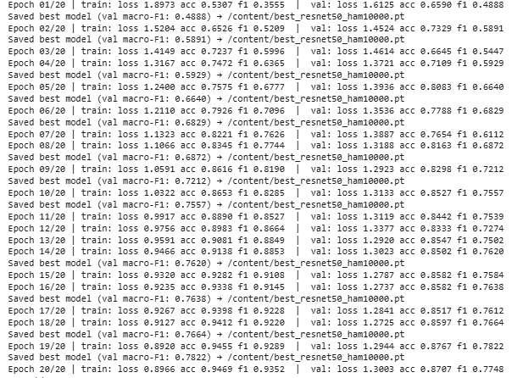
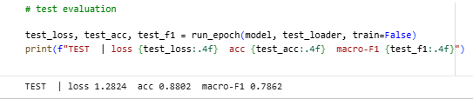
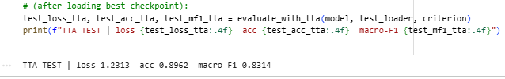
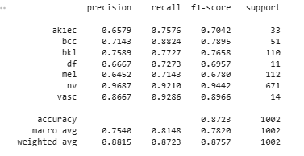
Results

Slide 7
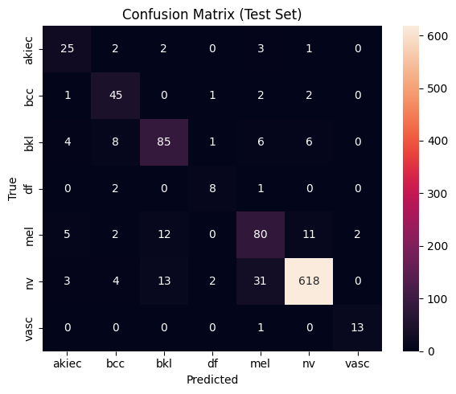
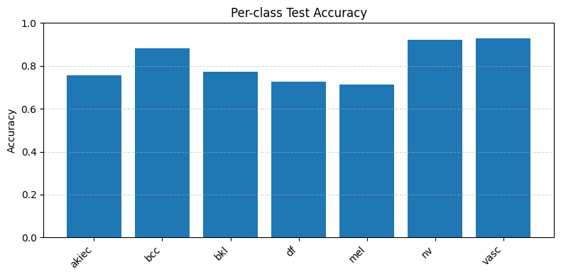
Per-class Test Accuracy

Slide 8
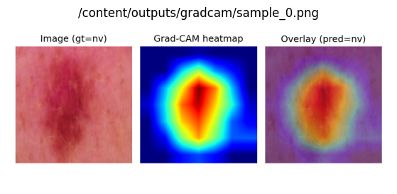
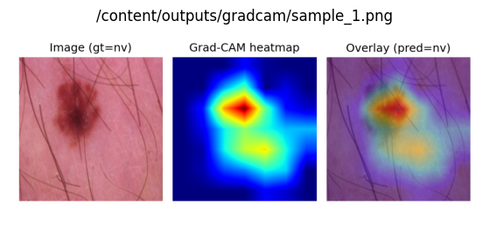
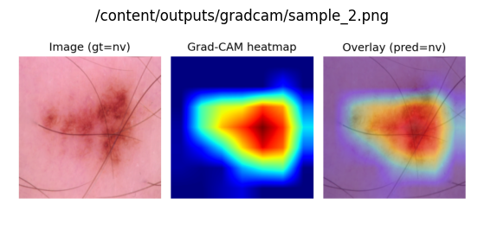
Grad-CAM
Coarse regional attention
Shows where the model focuses

Slide 9
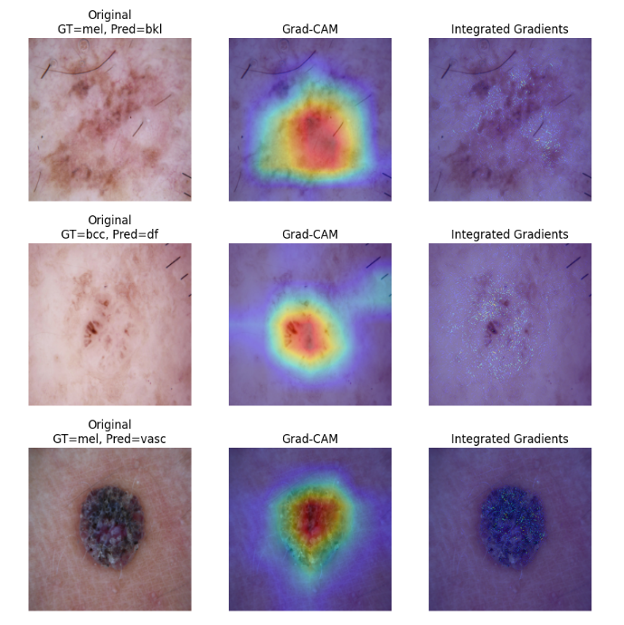
Integrated Gradients (IG)
Pixel-level attribution
Shows how much each pixel contributes
Prevents shortcut learning errors
Satisfies Sensitivity & Implementation Invariance

Slide 10
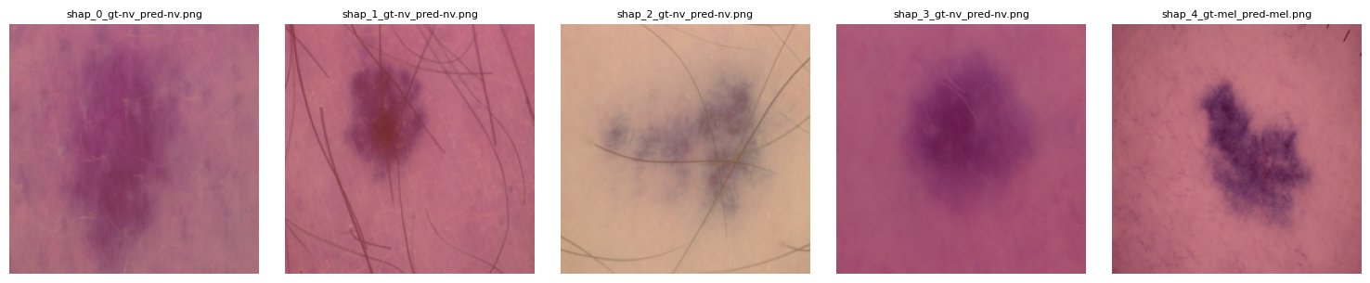
SHAP
Global & local feature attribution
Shows consistent patterns across dataset

Slide 11
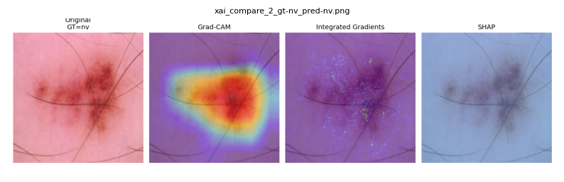
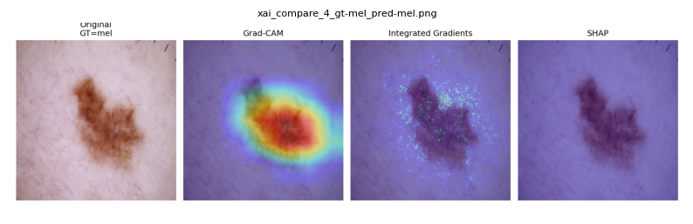
XAI Comparison

Slide 12
SOTA Comparison
Model | Dataset | Accuracy (Approx.) | Explainability Provided | Limitations
EfficientNet-B4 | ISIC / HAM10000 | 92–94% | Grad-CAM (coarse) | High accuracy but limited pixel-level interpretability
Vision Transformer (ViT) | ISIC | 90–93% | Minimal or Grad-CAM variants | Transformer attention maps do not provide clinical detail
Inception-v4 | ISIC | 89–92% | Grad-CAM | Strong feature extraction, weak explainability
Proposed Model: ResNet50 + XAI (Grad-CAM + IG + SHAP) | HAM10000 | 88–90% | Multi-level explainability: regional (Grad-CAM), pixel-level (IG), global (SHAP) | Slightly lower accuracy but far superior interpretability and clinical trust
SOTA models (EfficientNet, ViT, Inception-v4) achieve high accuracy
BUT: most offer weak interpretability
This project integrates:
Grad-CAM → global region
IG → pixel-level precision
SHAP → statistical insights
Achieves balanced accuracy + superior transparency
More clinically suitable than black-box SOTA CNNs

Slide 13
Future Work
Experiment
Experiment with EfficientNet, ConvNeXt, and Vision Transformers
Add
Add metadata (age, lesion location) for multi-modal learning
Apply
Apply segmentation or artifact removal (hair, rulers)
Deploy
Deploy as a clinical decision-support tool with interactive visualizations

Slide 14


